Slide 1

Bangladesh Army University of Science and Technology, Saidpur Cantonment, Nilphamari Department of computer science and engineering
Health management system
COURSE CODE: CSE 2206
Presented by:
Ahnaf khan sadaf Id:220101026
Mehedi Hasan id:220101003
Nubassim nushra id:220101004
Maisha Haque id:220101008
Presented to:
Hasan Muhammad kafi
Assistant professor
(DEPT. of cse)
Page :01

Slide 2

Introduction
Health management
Increased health deterioration
Giving basic consultation on health
Page :02

Slide 3
outline
Introduction
Objectives
Problem definition
Related applications
STAKEHOLDERS
ISSUES ENCOUNTERED
Tools and technology
Database system
System Architecture
IMPLEMENTATION
Conclusions
References
Page :03

Slide 4
Problem Definition
Society is now accustomed to diseases like blood pressure and diabetes, leading to widespread ignorance.
Lack of knowledge, effort, and resources prevents people from seeking regular check-ups.
The project aims to assist patients and their guardians in times of need.
The project targets situations where there are no nearby doctors or medical facilities available.
It seeks to address these issues to some extent and offer potential solutions.
Page :04

Slide 5
Objective
To help the patients in need of emergency medical advise
To reduce the possibility of normal illnesses like BP, diabetes, fever from getting extremely harmful for an individual
To create a healthy and better life
Page :05

Slide 6
Related application
There are a few websites and apps such as:
Nih.gov[1]
healthline.com[2]
Soft Clinic[3]
Although these websites are meant to be for medical purposes. They don’t give all the necessary facilities.
Their main problem is that they are only made and concentrated for certain regions of the world. Some are only for research purposes which is not very helpful for non-medical personals.
Page :06

Slide 7
STAKEHOLDERS
USERS: PATIENTS, THE ELDERLY, AND INDIVIDUALS WITH DISABILITIES RELY ON THE PLATFORM FOR HEALTH MANAGEMENT, ACCESSING MEDICAL ADVICE, AND HEALTH INFORMATION.
DOCTORS AND HEALTHCARE PROFESSIONALS: THEY USE THE DATABASE FOR PATIENT RECORDS, PRESCRIPTIONS, DIET PLANS, AND NURSING STEPS, AIMING TO PROVIDE EFFECTIVE HEALTHCARE SERVICES.
PHARMACEUTICAL COMPANIES: RELY ON THE DATABASE FOR ACCURATE DISEASE STATISTICS AND MEDICATION INFORMATION, AIDING RESEARCH, DEVELOPMENT, AND PHARMACEUTICAL PRODUCT DISTRIBUTION.
Page :07

Slide 8
ISSUES ENCOUNTERED
WE, AS CSE STUDENTS WORKING ON A HEALTH MANAGEMENT DATABASE, FIRST LEARNED PROJECT FUNDAMENTALS. DURING IMPLEMENTATION, WE ENCOUNTERED ERRORS AND SOUGHT HELP FROM VARIOUS SOURCES. GATHERING DATA REQUIRED INTERACTIONS WITH PATIENTS, DOCTORS, AND NURSES, INVOLVING HOSPITAL AND CLINIC VISITS. WE LEARNED SQL, ER DIAGRAMS, AND LIBRARY MANAGEMENT THROUGH TUTORIALS. TO COMPLETE OUR SYSTEM, WE USED MYSQL, HTML, VS CODE, CSS, AND LEARNED THEM THROUGH ONLINE TUTORIALS.
Page :08

Slide 9
System Architecture
Disease
Read
Description
Statistics
Patient / Naive user
Create
Medicine
User type
User
Nurse
Admin
Update
Diet
Create
Read
Update
Delete
Daily-Workout
Delete
Doctor
Patient / Naive user
Tools
Page :09

Slide 10
Database system
User acc
Acc
Doctor
Fitness
Log_T
1 User-ID
2 Password
1 D-ID
2 Name
3 Schedule
Daily-Workout
1 Heavy exercise
2 Light exercise
3 Yoga
Checkup
User type
Tools
1 Admin
2 User
1 Tools name
2 Price
Monitoring
Disease
Medicine
Prescription
1 Name
2 Company Name
3 Price
1 Info
2 Management
Diet
1 Breakfast
2 Lunch
3 Dinner
Healthy
Statistic
Care
Nurse
Statistic
1 Disable
2 Pregnancy
Description
1 Symptoms
2 Types
Symp
1 Disease_statistic_(world)
2 Disease_statistic_(BD)
Page :10

Slide 11
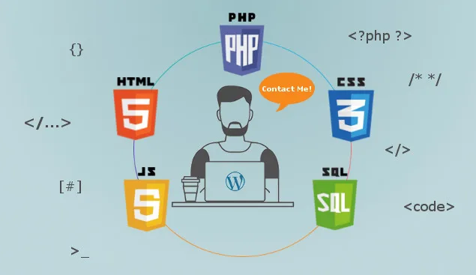
Tools and technology
MySQL
Php
Css
Html
Sql
Page :11

Slide 12
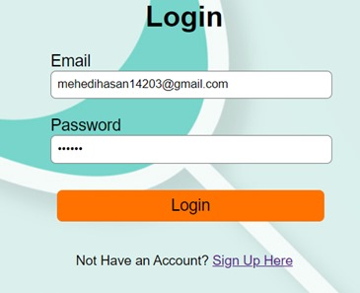
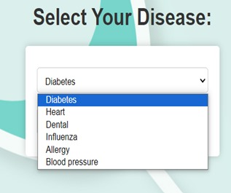
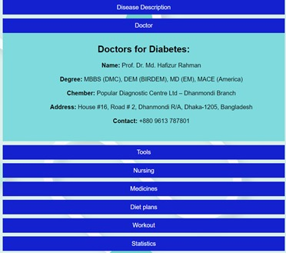
IMPLEMENTATION
Page :12

Slide 13
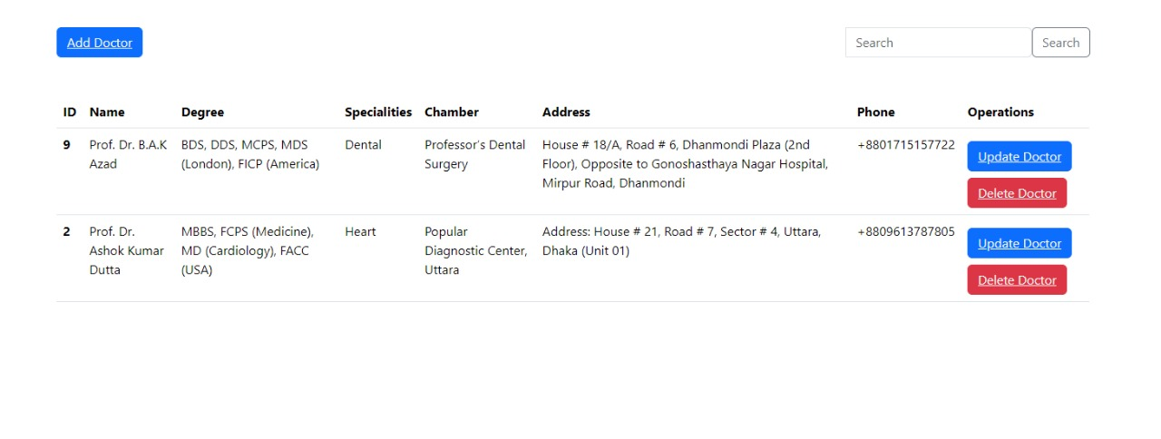
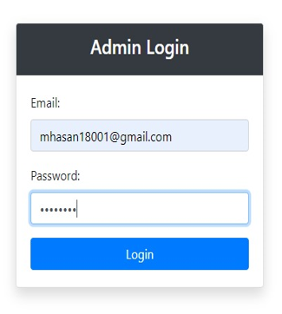

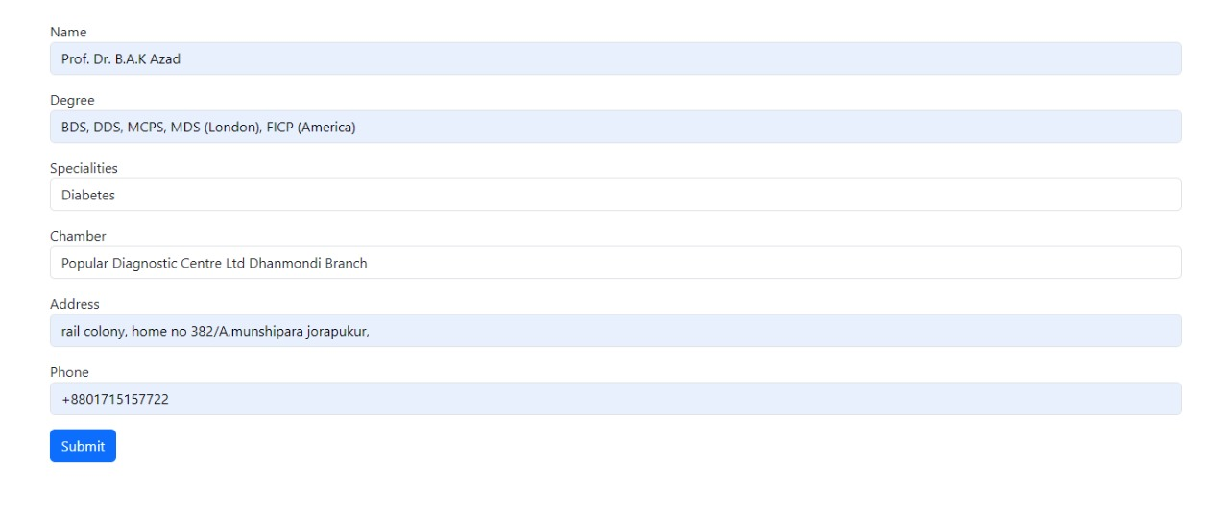
IMPLEMENTATION
Page :13

Slide 14
Conclusion
The online healthcare database project greatly improves healthcare management and accessibility. It addresses data integration, user authentication, patient management, and disease statistics, providing a user-friendly platform for healthcare data access.
Page :14

Slide 15
LIMITATIONS
SCALABILITY CHALLENGES: THE PROJECT MAY FACE LIMITATIONS IN HANDLING A SIGNIFICANT INCREASE IN USERS AND DATA VOLUME, NECESSITATING DATABASE SCALING STRATEGIES AND PERFORMANCE OPTIMIZATION.
REGULATORY COMPLIANCE: STAYING COMPLIANT WITH EVOLVING HEALTHCARE REGULATIONS AND DATA PRIVACY LAWS IS AN ONGOING CHALLENGE, REQUIRING REGULAR UPDATES AND ADHERENCE TO INDUSTRY STANDARDS TO ENSURE DATA SECURITY AND PRIVACY.
LIMITED FEATURE SET: WHILE THE PROJECT COVERS ESSENTIAL HEALTHCARE MANAGEMENT FEATURES, THERE'S POTENTIAL FOR ADDING MORE ADVANCED FUNCTIONALITIES LIKE INTEGRATED TELEMEDICINE AND REAL-TIME DATA ANALYTICS TO ENHANCE CAPABILITIES.
Page :15

Slide 16
references
https://www.nih.gov/
https://www.healthline.com
https://www.techpout.com/hospital-management-software/#1_Soft_Clinic
Page :16

Slide 17
THANK YOU
EVERYONE
Page :17

